Slide 1


Slide 2

Paint it Black
Dark Mode Dashboards

Slide 3


Valerie Junk
PorcuBI
The Netherlands
www.linkedin.com/in/valeriejunk/
porcubi
info@porcubi.nl
www.porcu.bi

Slide 4
Topics Covered
Why (not) dark mode?
Does it make sense?
How to rock it?

Slide 5
Why Dark mode?

Slide 6
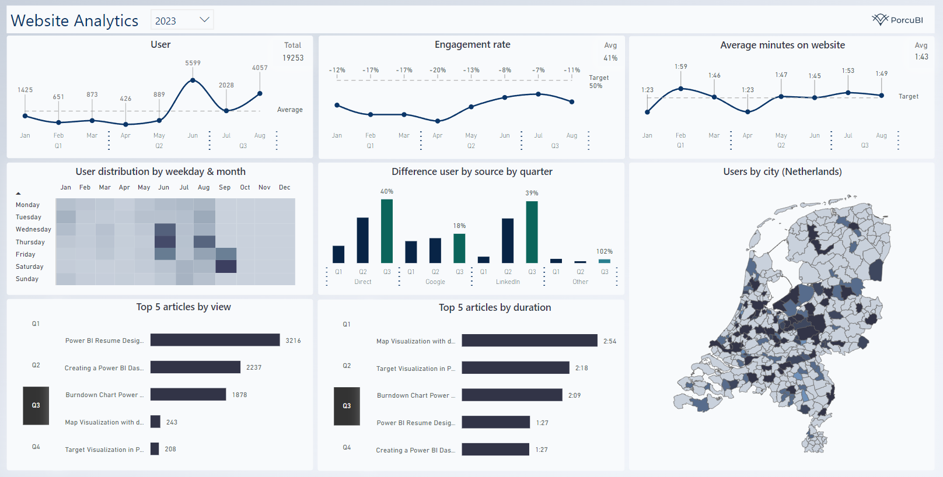
Why?
This works fine?!

Slide 7

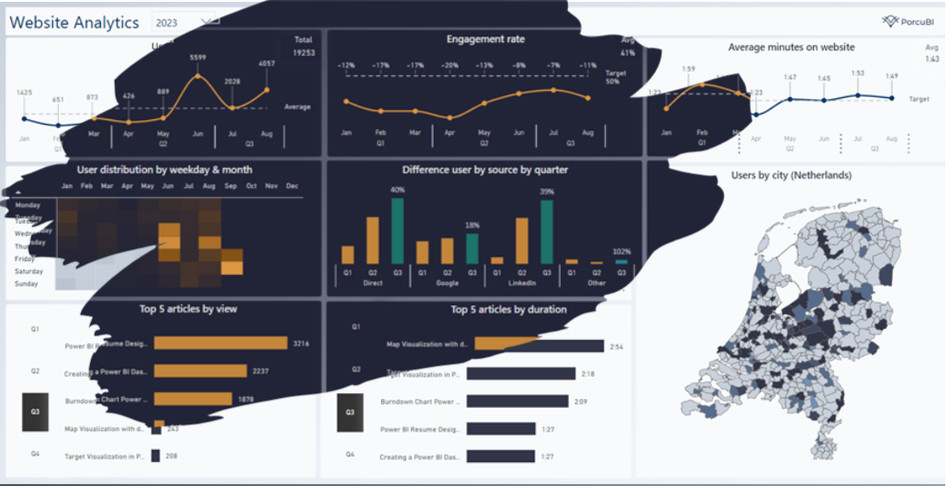
Why?
Comfortable viewing
Focus
Consistent experience (other tools)
Visually appealing

Slide 8
Why not?

Slide 9
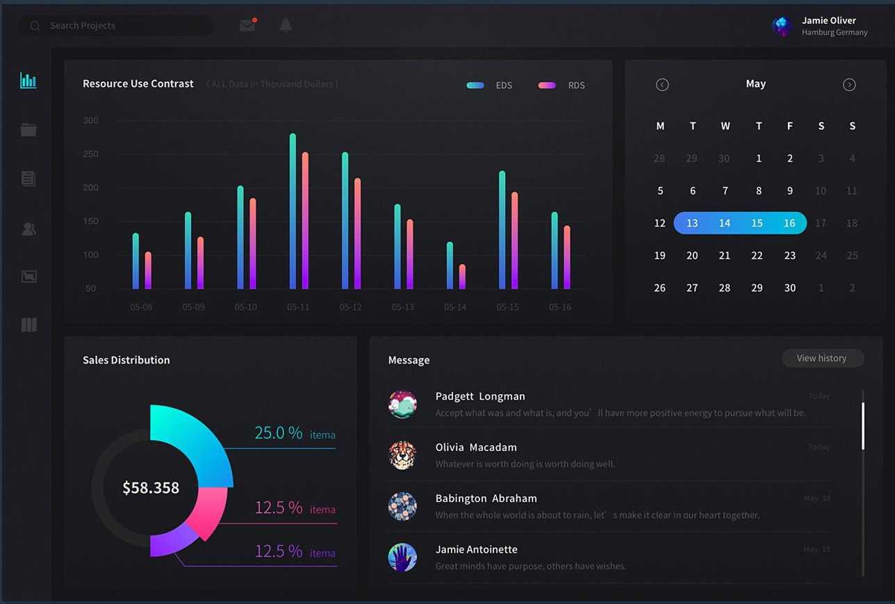
Why not?
Hard to maintain
Contrast
Focus/Attention
Readability
Accessibility
Less colors possible

Slide 10
Does it make sense?

Slide 11

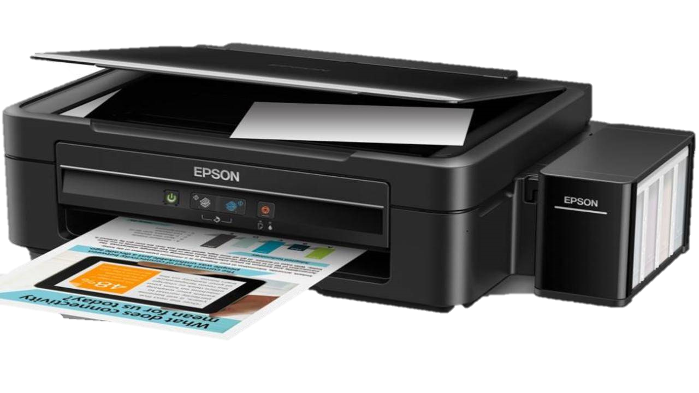
Design for the User.
Does the user benefit from it?
Support Team
Company Wide
“I need a copy of that”

Slide 12
How to rock it?

Slide 13
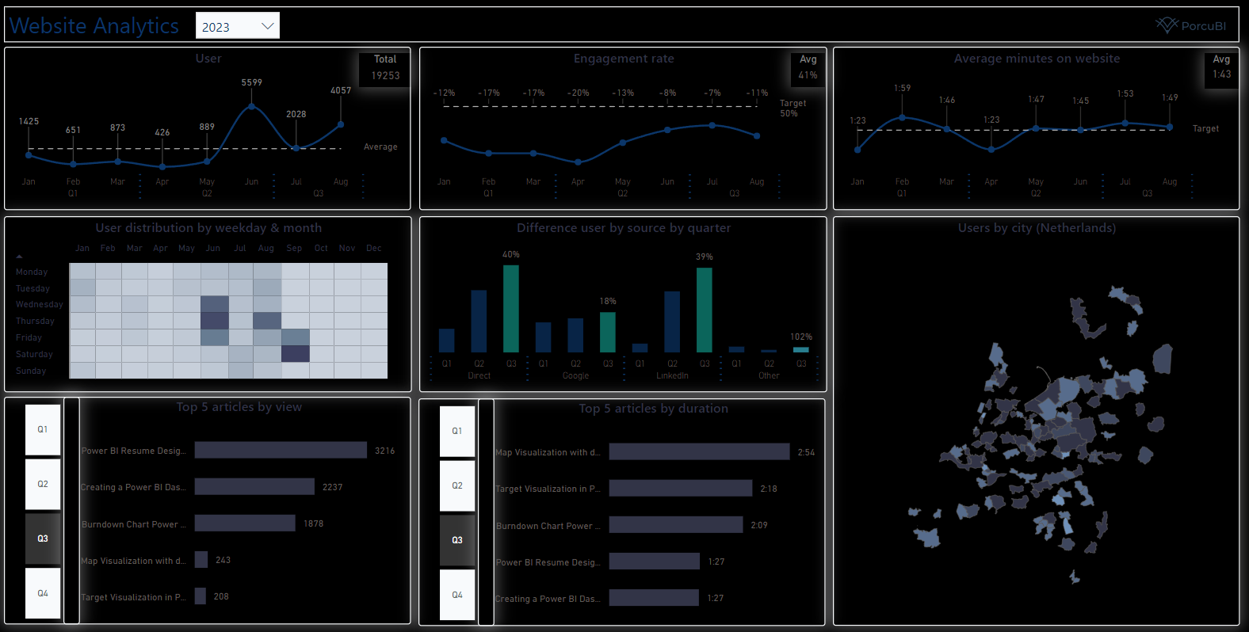
Dark Mode ≠ black

Slide 14
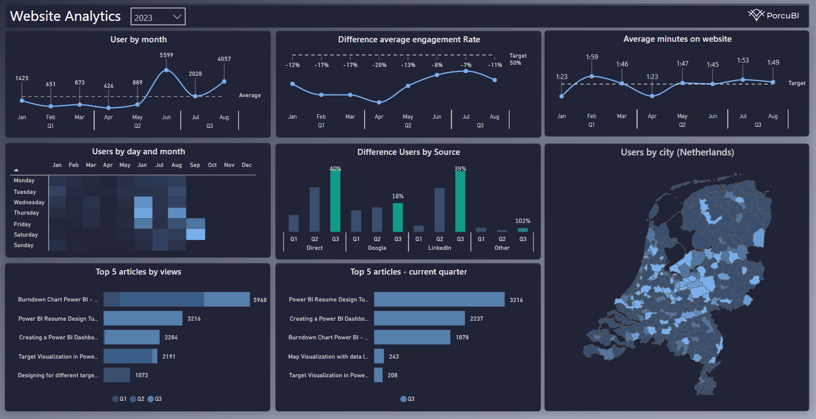
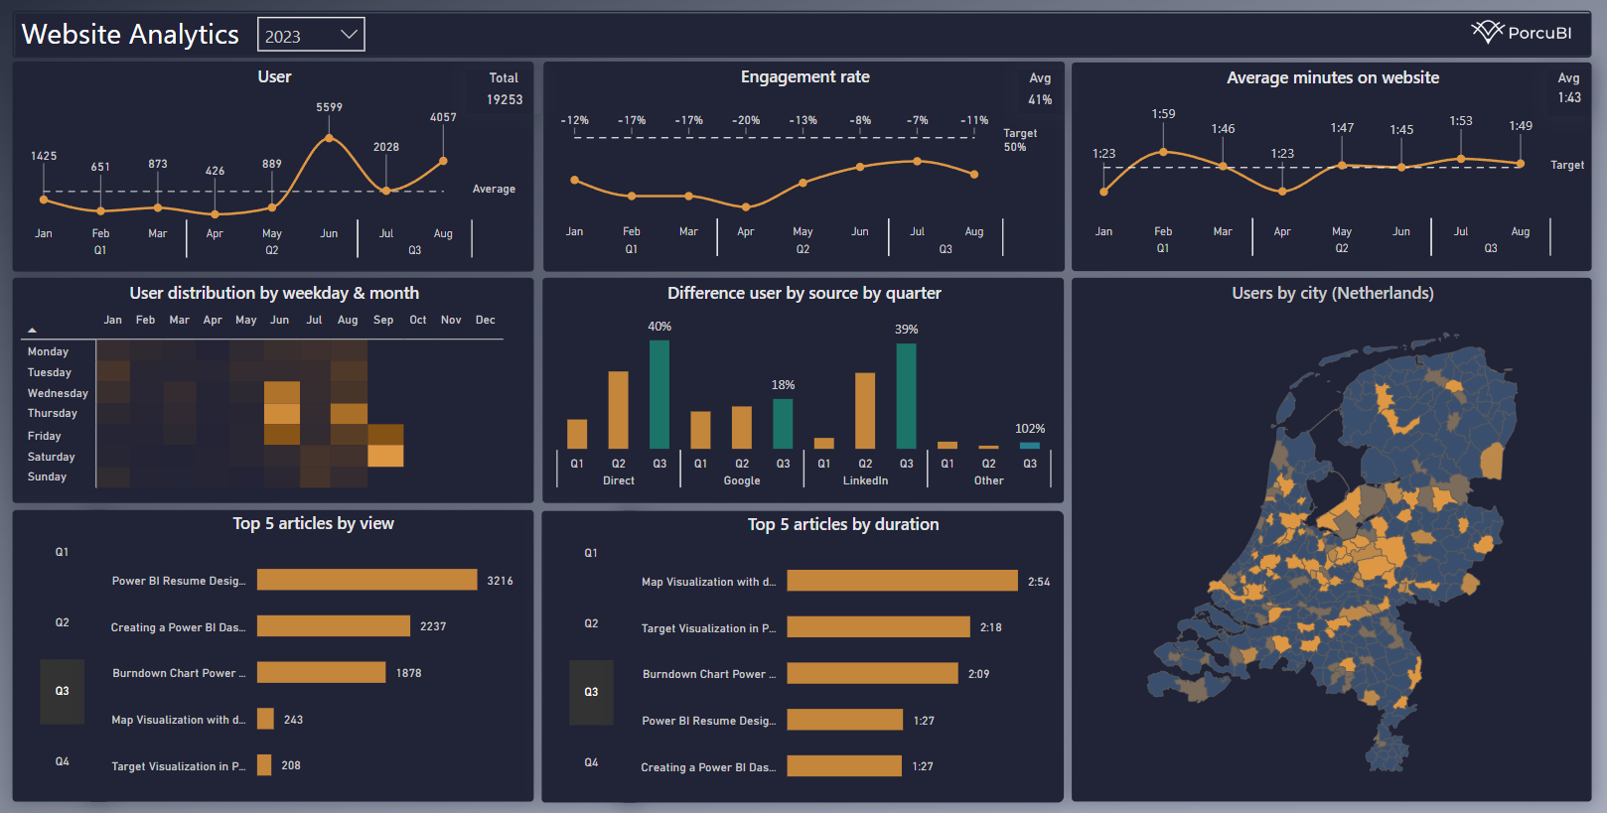

Choose wisely

Slide 15
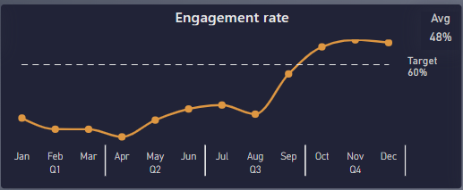
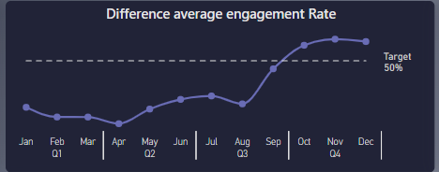
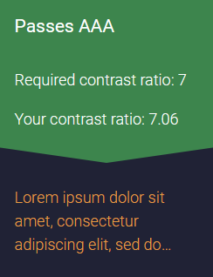
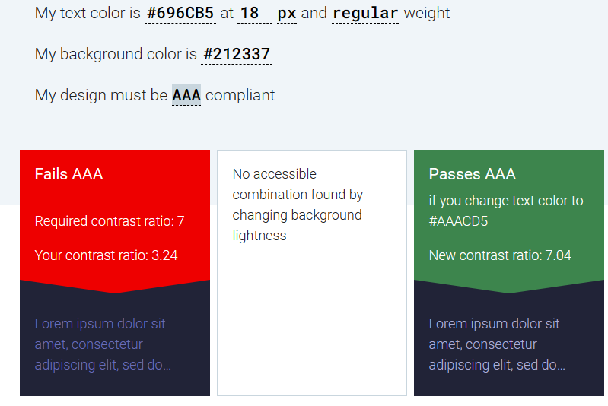
Contrast
https://accessible-colors.com/

Slide 16
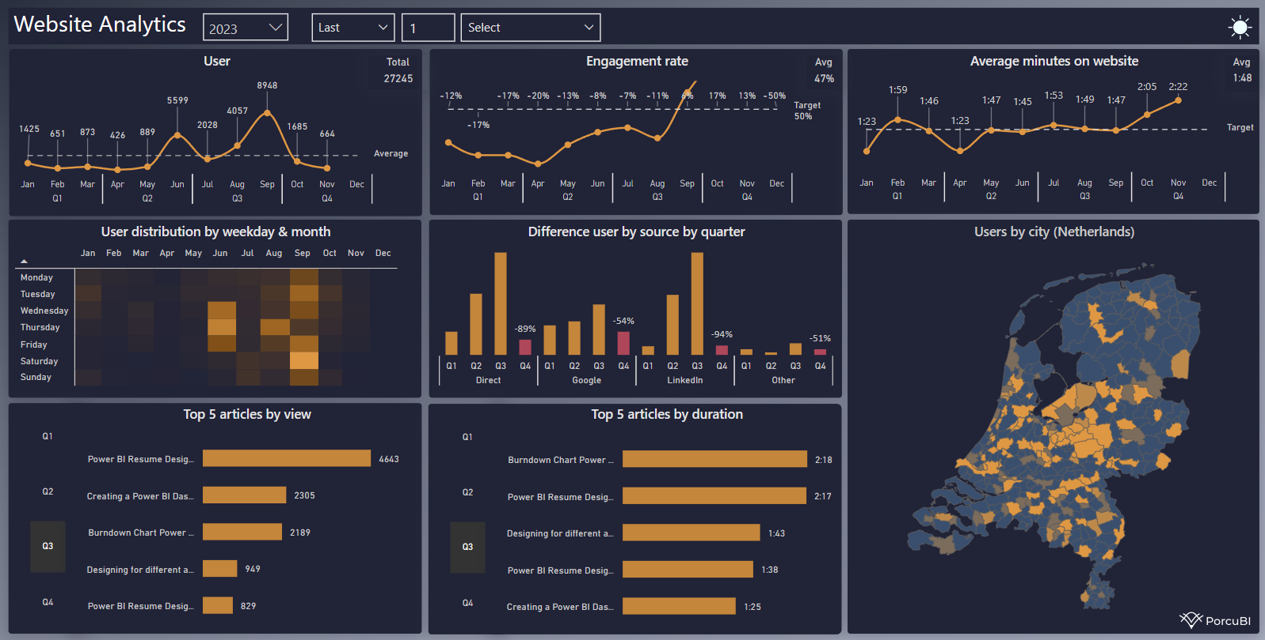
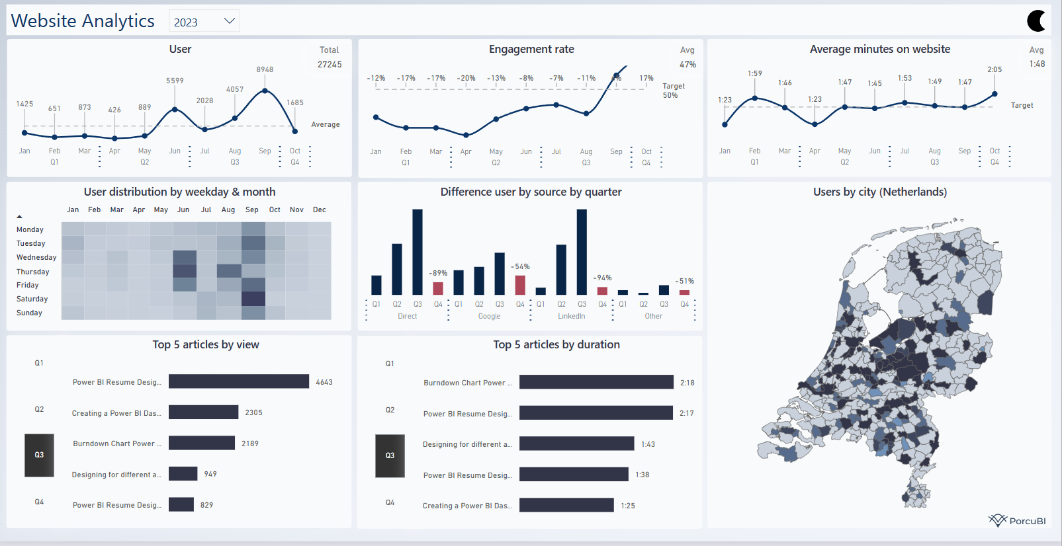
Provide Options
Toggle button or Icons
Separate pages
DAX to change colors dynamically

Slide 17
Valerie Junk
PorcuBI
The Netherlands
www.linkedin.com/in/valeriejunk/
porcubi
info@porcubi.nl
www.porcu.bi

Slide 18


